Slide 1

Ausome connections
Friendships on the spectrum

Slide 2


Slide 3
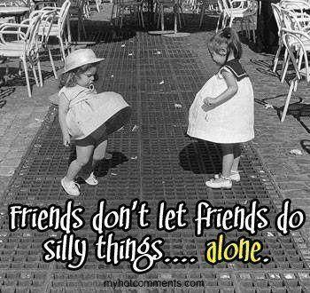

Slide 4


Slide 5
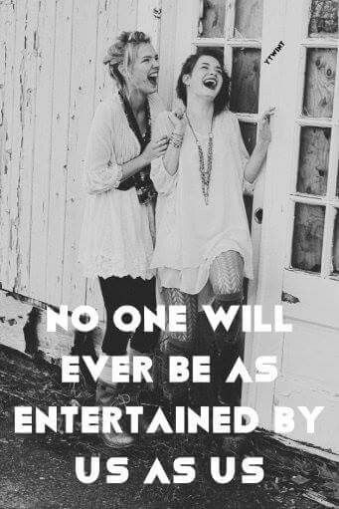

Slide 6


Slide 7
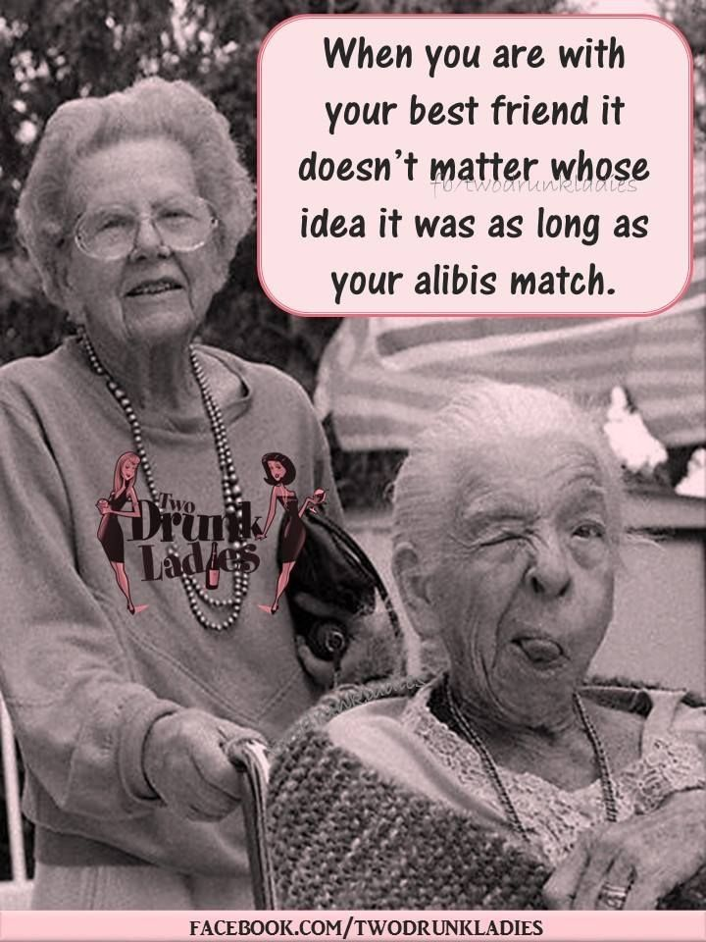

Slide 8
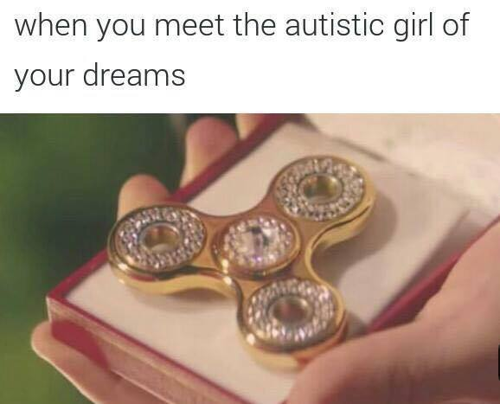

Slide 9
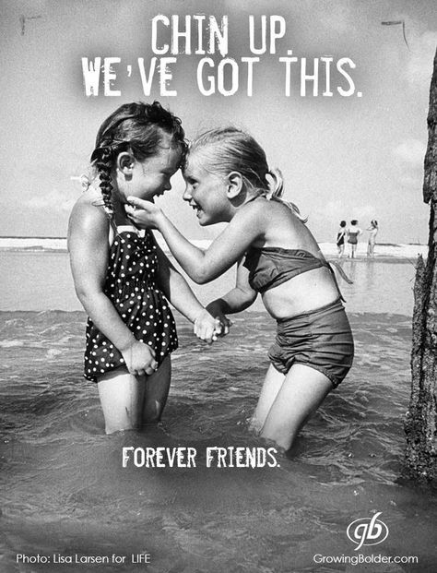

Slide 10
Autistic friends:
Loyal
Genuine
Unpretentious
Honest
Direct
Appreciate you for who you are

Slide 11
Friendships & Autism
Usually lower social drive — have a few well-chosen friends
Words less important than actions
Sharing space & time
Conversations tend to be meaningful

Slide 12
Autism is a social & communication disability
People want to feel socially competent
Therefore, because Autistic people tend to be socially “out of synch,” it’s usually confident people who are comfortable being in our chosen circles.

Slide 13
Neurotypical route to social success and happiness:
Fit in, genetic, conform = social acceptance & safety
Initiate social interactions, reach out
⭐️ NT end result: larger circle, more socializing, more outings in community

Slide 14
Autistic route to social success and happiness
Be ourselves 😎
Enjoy our passions
Choose our circle wisely- those who perceive & appreciate our strengths
Natural Autistic engagement style is to share space & time, not so much eye contact, smalltalk, etc.
⭐️ Autistic end result: Be appreciated for who we are. Sense of belonging, connections through our passions, easier, streamlined social schedule. ⭐️

Slide 15
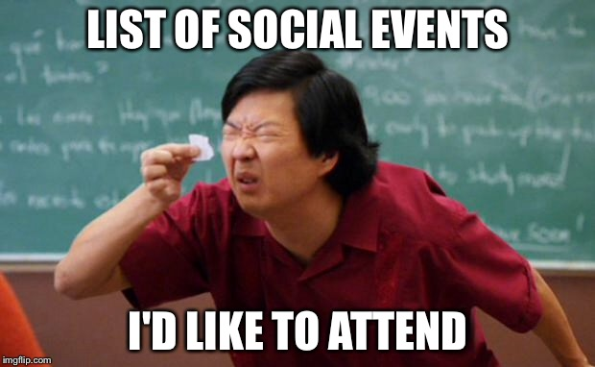

Slide 16


Slide 17
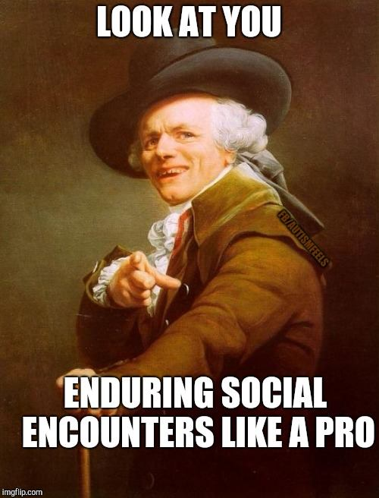

Slide 18
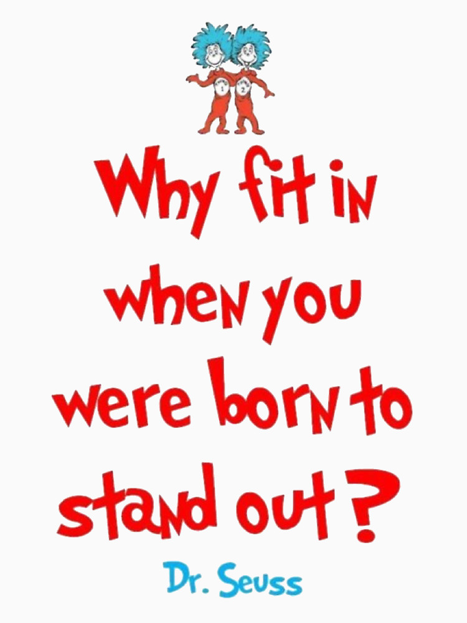

Slide 19
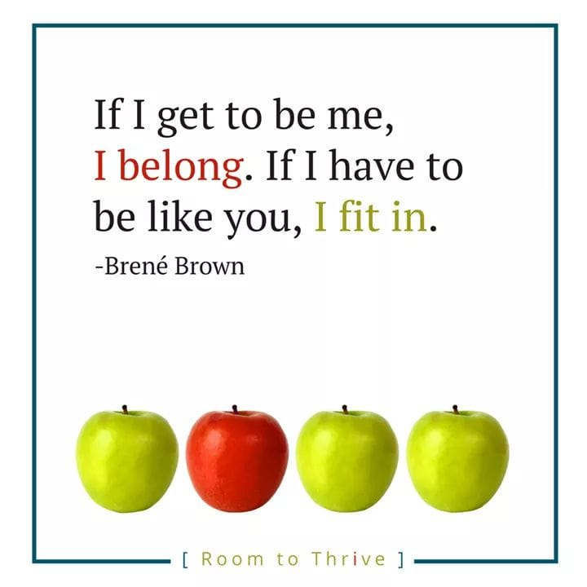

Slide 20
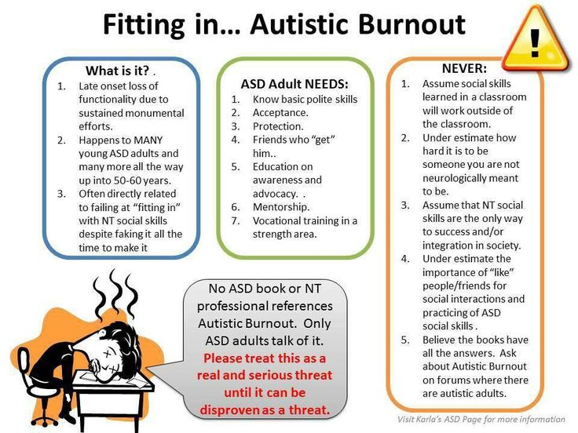

Slide 21
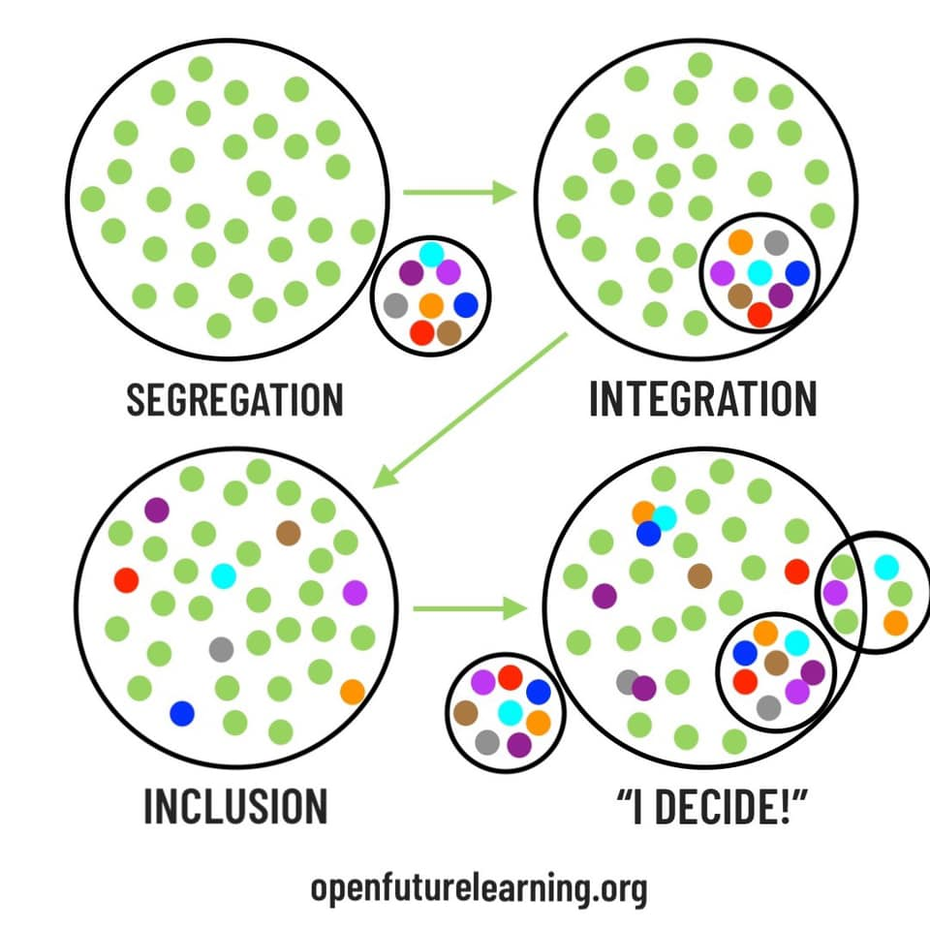

Slide 22
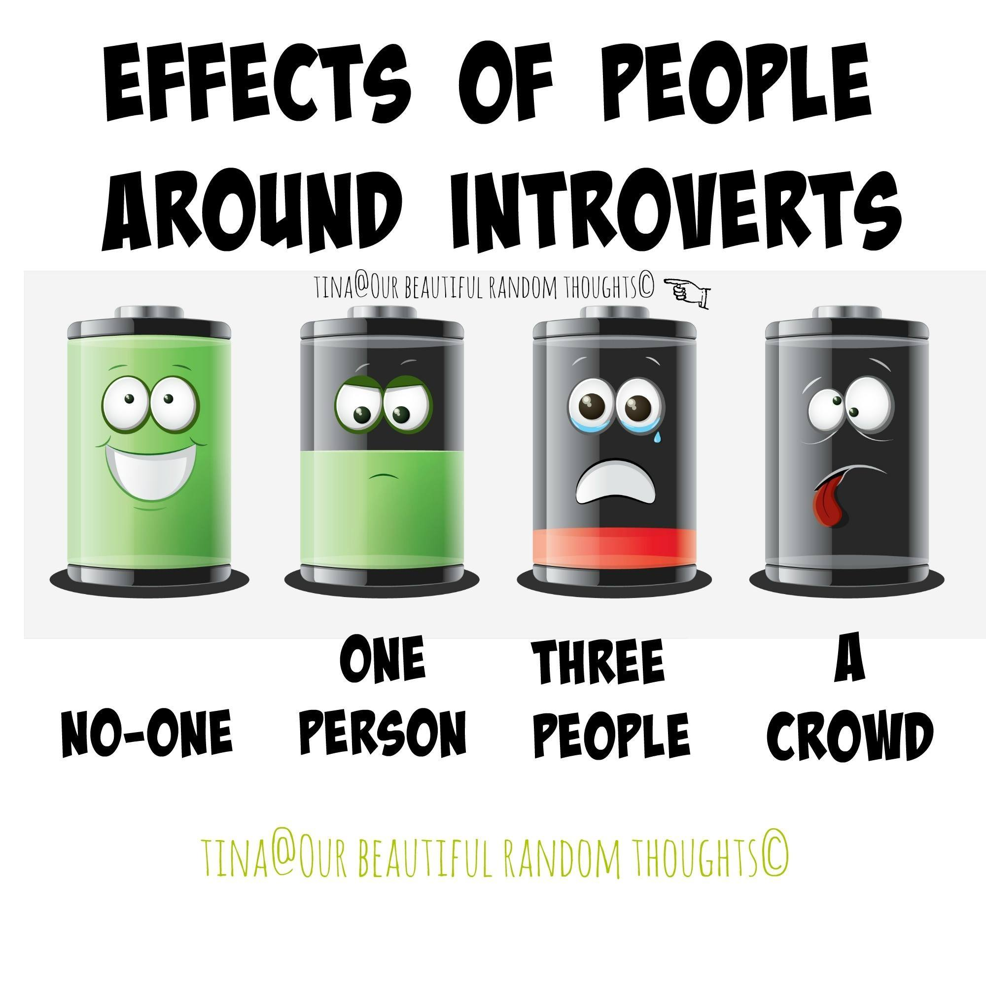

Slide 23
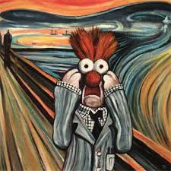

Slide 24
Social rules are never intuitive for Autistic people, and we all prefer to do what we’re good at.
“Social Energy drain Full-body migraine” as our social batteries lower, being drained is physically painful.
Expect judgement & rejection for not being able to intuit social rules
Anticipate pressure to socialize (groups, clubs, scouts)
Our authentic Autistic style of social engagement isn’t recognized for the warmth of connection/ emotional reciprocity it is.

Slide 25


Slide 26
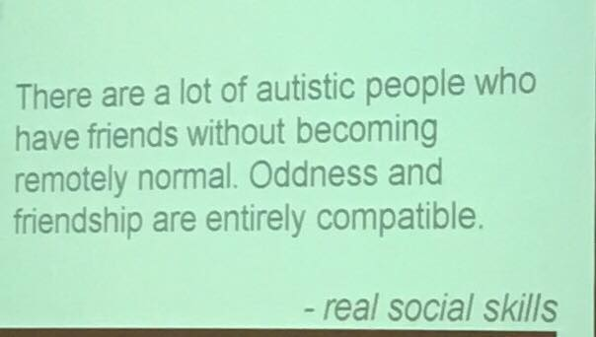

Slide 27

Meditation

Slide 28
Please remember...
Initiating social interaction may look different, may be something the person’s neurology isn’t wired for, or may take time for to become comfortable with someone. Be patient.
We want genuine friends, not to have “assigned friends.”
Having another person plan social goals for you feels: inappropriate, presumptive, invasive, “oogey.”
Support natural Autistic engagement styles
Teach manners— we all need to learn to be polite
⭐️ Become comfortable yourself with the real degree of social drive the person actually has ⭐️

Slide 29
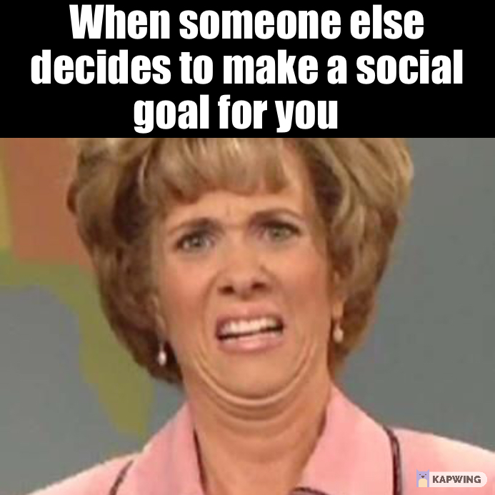

Slide 30
How to support Autistic people for social success & happiness ⭐️

Slide 31
positive autistic self-concept for social engagement

Slide 32
To want to socialize,
We need a
✨ positive self-image
including our autism .
😎💪⭐️

Slide 33
Autism is an ✨identity✨
Before it’s a diagnosis
😎

Slide 34
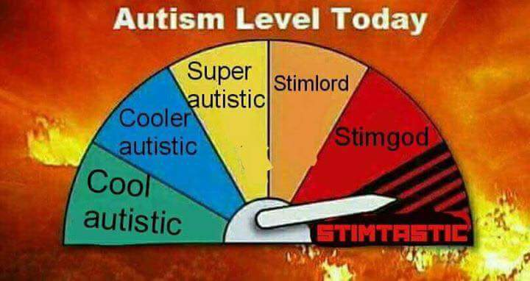

Slide 35


Slide 36
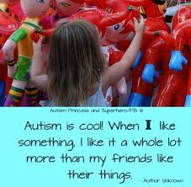

Slide 37
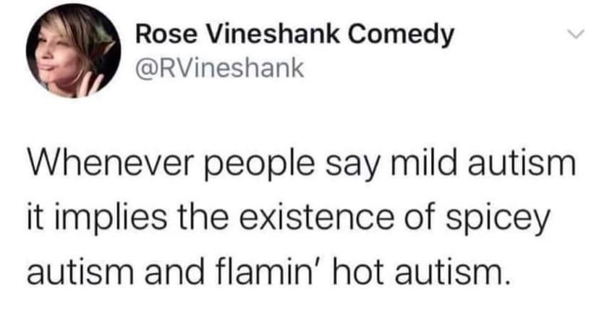

Slide 38
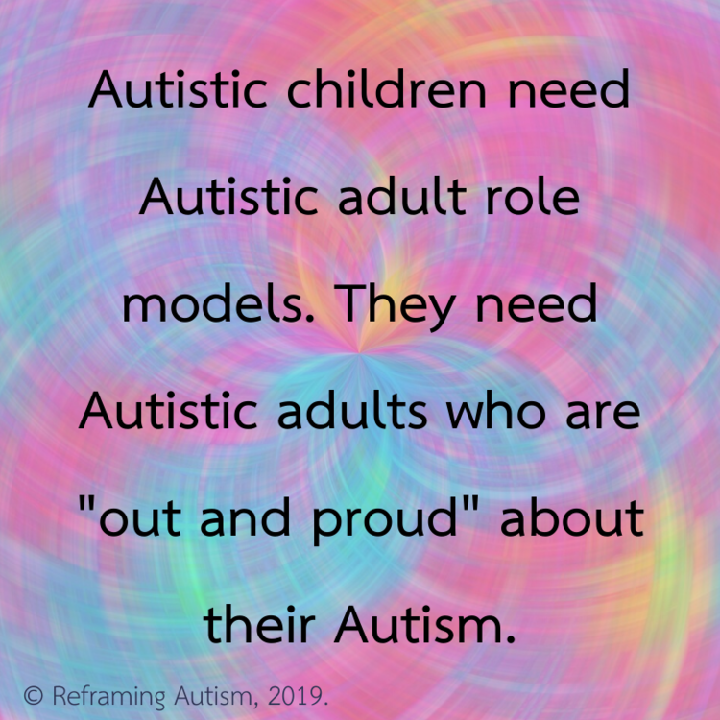

Slide 39


Slide 40
Keep the mind fresh 🌻 & increase social drive

Slide 41
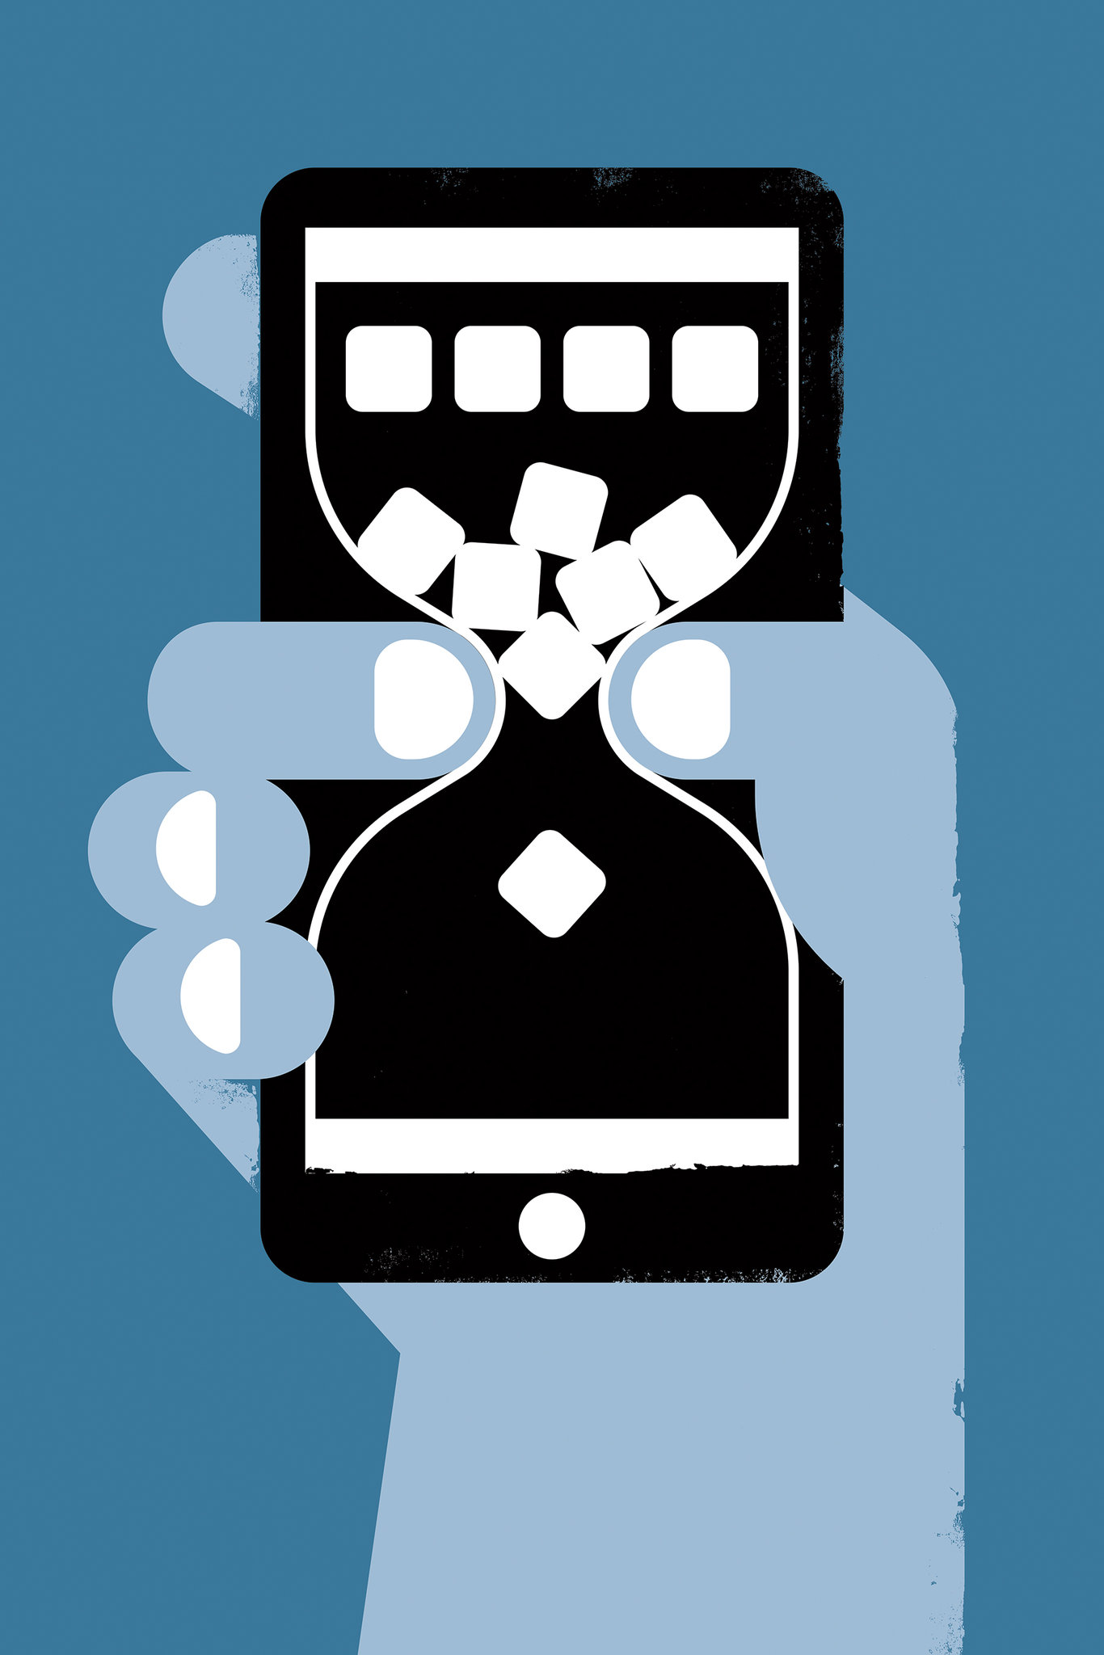
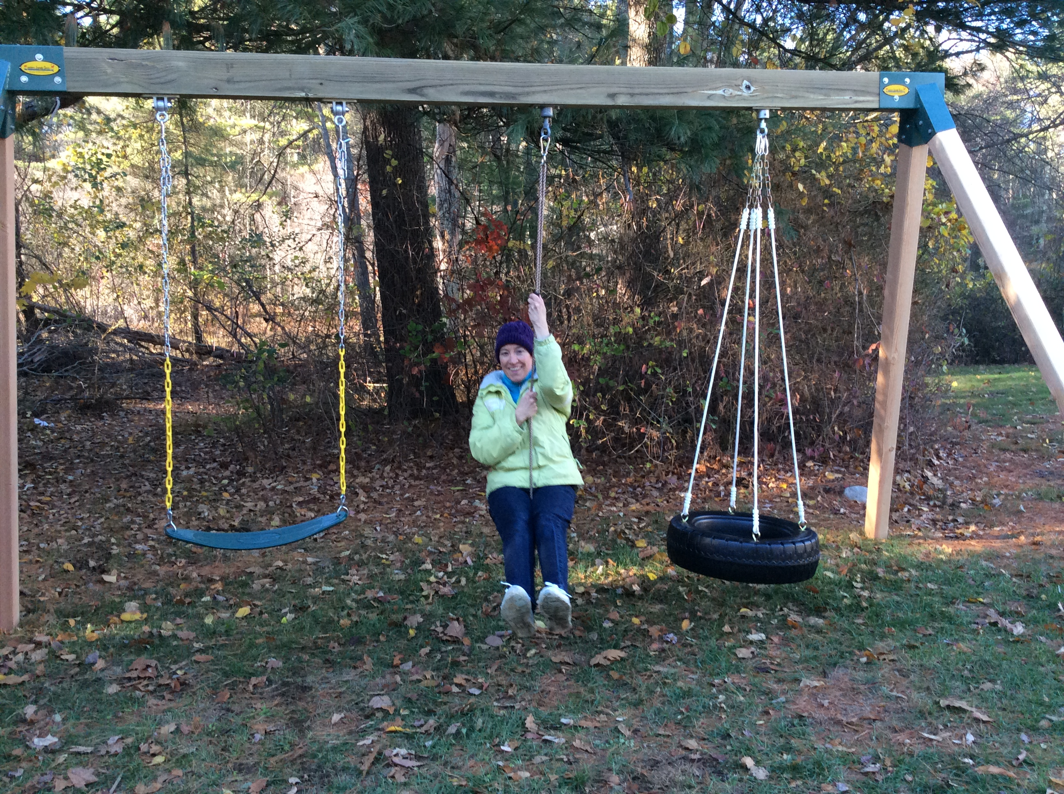
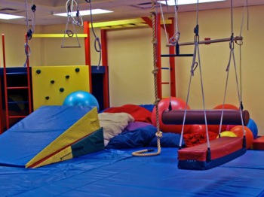

Slide 42
Shared interests 😎

Slide 43
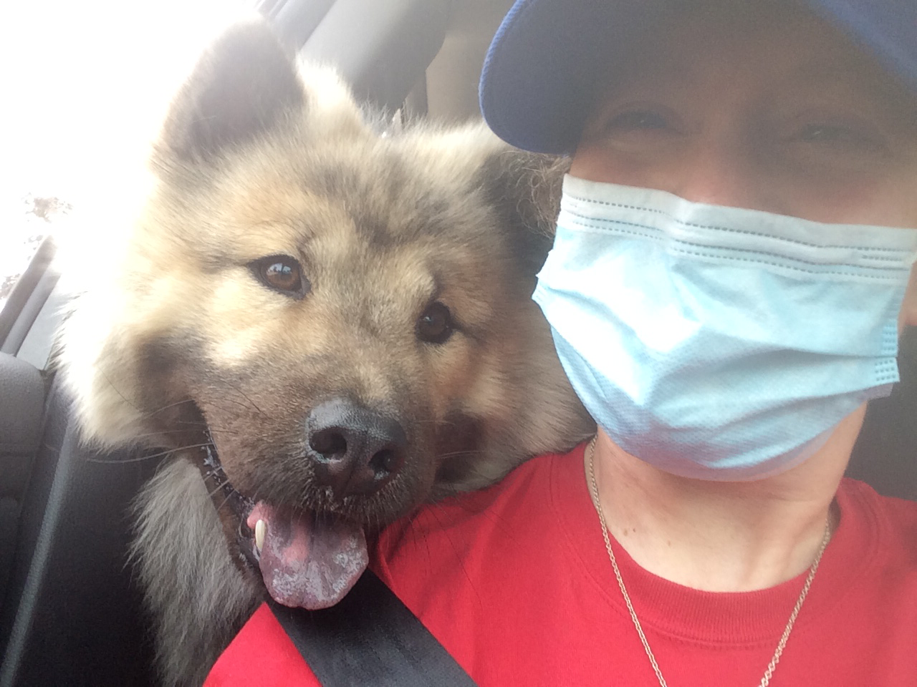

Slide 44
Autistic people must budget our social energy
Friends who “get us” recognize our Autistic style of connecting, even though it looks different.
We decide how much social engagement we can handle

Slide 45


Slide 46

buffers of solitude

Slide 47
Respect our differences in engagement styles— friendships come in all flavors 🍦🍧🍡

Slide 48
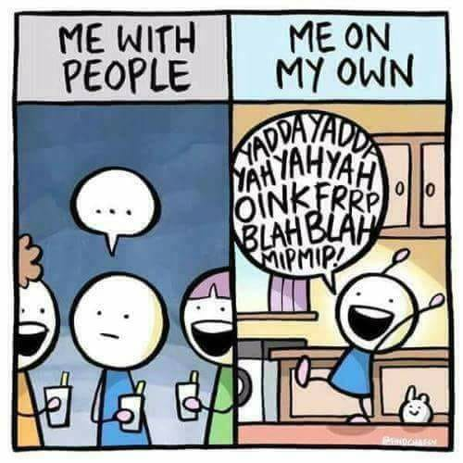

Slide 49
Non-compliance (Setting healthy boundaries) is a social skill which must be taught for our social safety & internal wellbeing 🌿

Slide 50
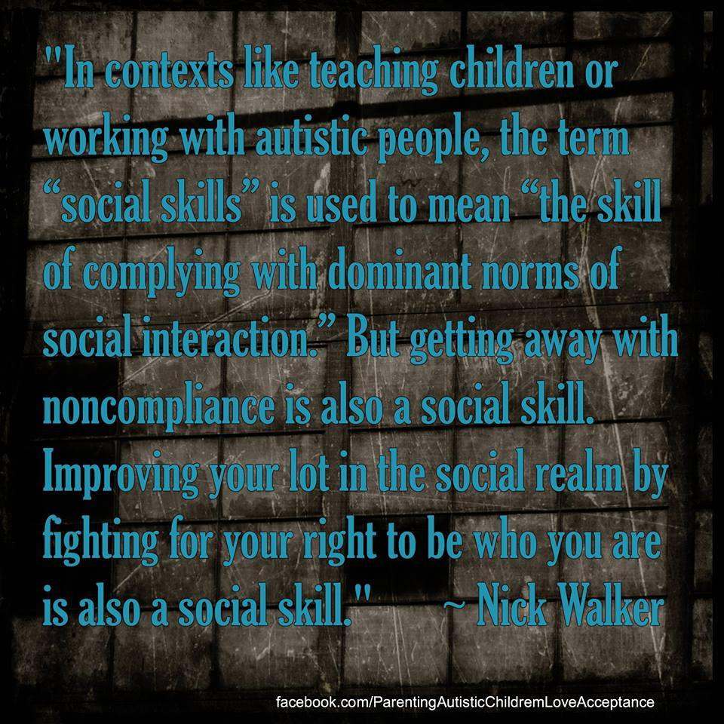

Slide 51
Social skills tips for NTs
Need an Autistic guide as well as an NT guide, representation of Autistic perspectives is vital. NTs need a translator.
Must have clear awareness that Autistic social drive is usually lower.
Autistic social energy battery may already be in the red zone prior to increased social demands
Never expect social skills taught to carry over beyond a classroom setting. Social rules aren’t intuitive for Autistic people, instead, remembering and applying social rules is done manually. (Extremely draining.)

Slide 52
Autistic social skills
Learn to choose your circle
Find your tribe
Be true to your neurology — Be yourself
Be polite
Use your passions to connect
Streamline your social calendar

Slide 53
How to choose our circle
Know that we stand out as socially different
Confidant, secure people feel comfortable around those with social differences
Insecure people feel incompetent around anyone who is socially out-of-sync
Choose those comfortable with you being exactly who you are.

Slide 54
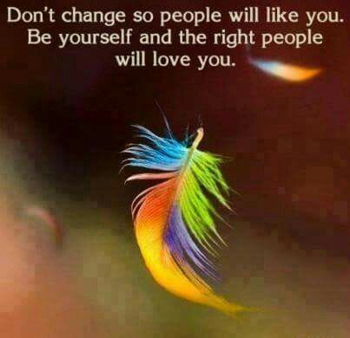

Slide 55
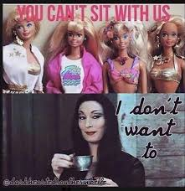

Slide 56
Interbeing skills
Teach neurotypical people to feel comfortable around difference AND DISABILITY
Openly recognize the contributions of the disabled among our communities
Model value, appreciation, and respect for how these contributions support our communities
Hire from the disabled community. ⭐️Representation is the highest form of inclusion.⭐️

Slide 57
Laughter! We all need it. 😄

Slide 58


Slide 59
Autistic people don’t need to fit in,
We *all* need to belong. 😎

Slide 60
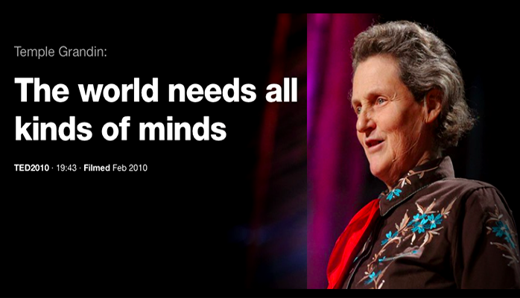

Slide 61
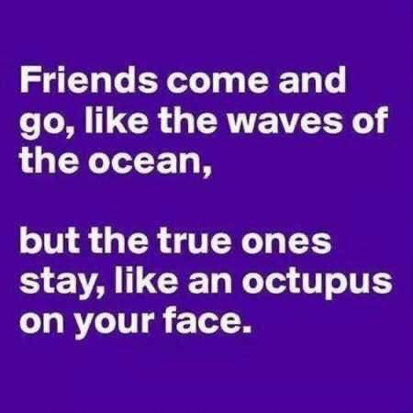

Slide 62


Slide 63
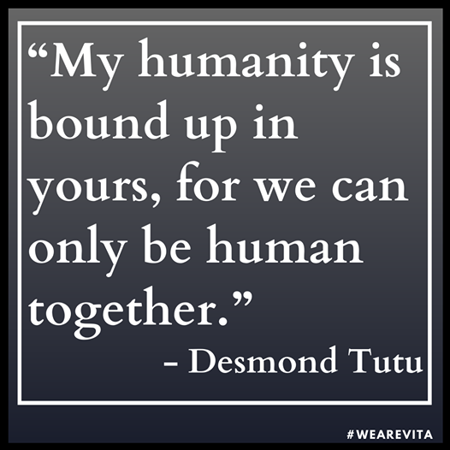

Slide 64
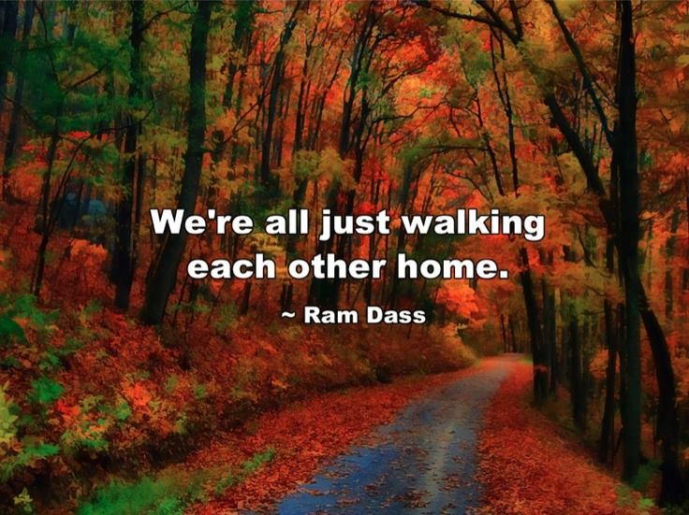

Slide 65


